Slide 1

Predicting Property Values
By Moshe Burnstein

Slide 2

Agenda
Business Problem
Background
/ History
Models
Analysis
Recommendations
Ethical Issues
References

Slide 3

Business Problem
Predict New York City Property Values
Clarity Builds Trust
Buyers, Sellers, and Investors
Robust Real Estate Market

Slide 4

Drivers of Real Estate Value
Location
Square Footage
Comparable Properties
Age of Property
Condition
Strength of Economy
Interest Rates
Income Approach
Lenders, Buyers, Sellers Need to Know
This Photo by Unknown Author is licensed under CC BY-NC
This Photo by Unknown Author is licensed under CC BY-NC

Slide 5
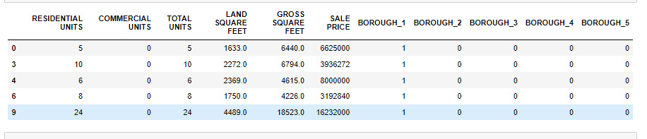
Snapshot of Dataframe
Manhattan(1)
Bronx(2)
Brooklyn(3)
Queens(4)
Staten Island(5)

Slide 6
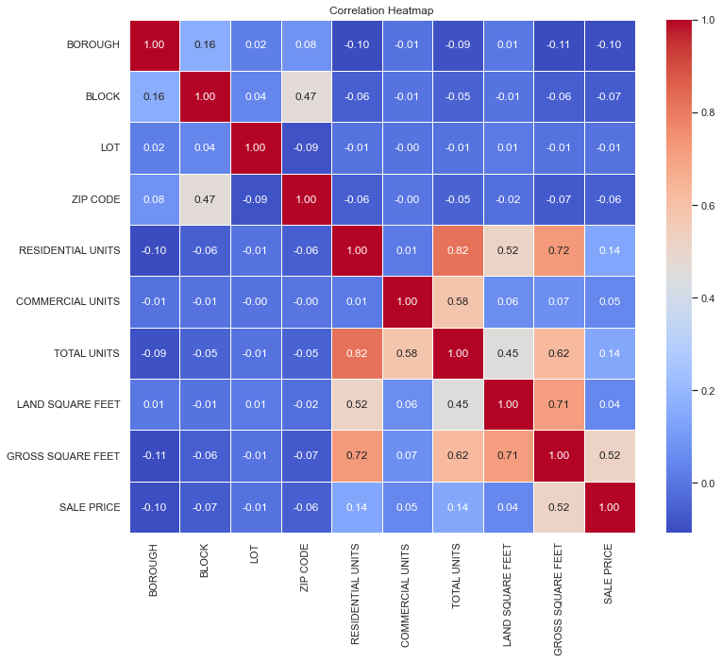
Correlations

Slide 7
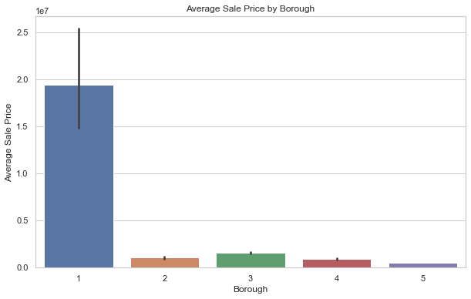
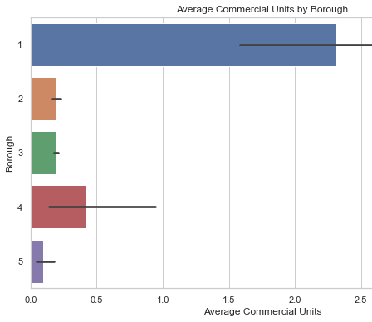
Manhattan Outpaces in Price and Units

Slide 8
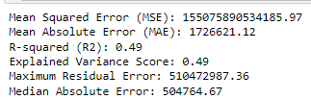
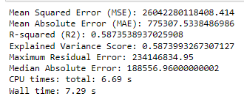
Models
Linear Regression on all Features
RandomForest

Slide 9
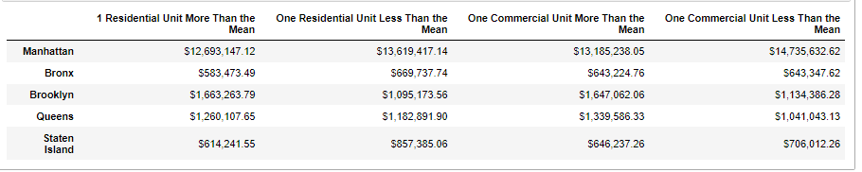
Price Affected by Units…Income Approach?

Slide 10

Recommendations
Use
Use the Random Forest Model
Feed
Feed it Borough, Square Footage, and Units
Leverage
Confidently Leverage Predictions
Monitor
Constantly Monitor Model
Explore
Explore New Features
Factor in
Factor in Current Climate…Interest Rates, Politics

Slide 11

Ethical Issues
1. Clearly Document Data Preprocessing
2. Ensure Legality of Using Personal Data
3. Explain Mechanics of Models
4. Still a Prediction, Albeit a Good One
5. Special Sensitivity From Real Estate Community
6. Gentrification
7. Open Lines of Communication With Locals
8. Ethical Audits

Slide 12
References
Glossary of terms for property sales files - nyc.gov. (n.d.). https://www.nyc.gov/assets/finance/downloads/pdf/07pdf/glossary_rsf071607.pdf
C. of N. York (2017, September 22). NYC property sales. Kaggle. https://www.kaggle.com/datasets/new-york-city/nyc-property-sales
Historic housing discrimination in the U.S. Habitat for Humanity. (n.d.). https://www.habitat.org/stories/historic-housing-discrimination-us#:~:text=Black%20families%20were%20prevented%20from,redlined%E2%80%9D%20areas%20unsafe%20for%20lending.
Numeracy, Maths and statistics - academic skills kit. (n.d.). https://www.ncl.ac.uk/webtemplate/ask-assets/external/maths-resources/statistics/regression-and-correlation/coefficient-of-determination-r-squared.html
Real estate contract basics. Wise. (2017, June 7). https://wisepropertymanagement.com/real-estate-contract-basics/#:~:text=Consideration%20is%20anything%20of%20legal,contract%20is%20not%20legally%20enforceable.
Rolling Sales Data. (n.d.). https://www.nyc.gov/site/finance/property/property-rolling-sales-data.page
Simple linear regression. (n.d.). https://sphweb.bumc.bu.edu/otlt/MPH-Modules/BS/R/R5_Correlation-Regression/R5_Correlation-Regression4.html#:~:text=There%20are%20four%20assumptions%20associated,are%20independent%20of%20each%20other.
SoFi. (2023, December 31). 7 important factors that affect property value. https://www.sofi.com/learn/content/factors-that-affect-property-value/
The three approaches to value - province of Manitoba. (n.d.-b). https://www.gov.mb.ca/mao/public/fact_sheets/approaches_to_value.pdf
Wall, S. (2023, June 26). Brokers criticize LLC transparency act. The Real Deal. https://therealdeal.com/new-york/2023/06/26/brokers-cry-privacy-in-pushback-on-bill-exposing-llcs/
What is Random Forest?. IBM. (n.d.). https://www.ibm.com/topics/random-forest#:~:text=Random%20forest%20is%20a%20commonly,both%20classification%20and%20regression%20problems.
Zach. (2021, April 12). What is the Assumption of Independence in Statistics?. Statology. https://www.statology.org/assumption-of-independence/

Slide 13
Thank You
Moshe Burnstein
https://github.com/mosheburnstein0/BurnsteinPortfolio
https://mosheburnstein0.wixsite.com/moshe-burnstein-s-da
https://www.linkedin.com/in/moshe-burnstein/

